Slide 1

HK610 Implementation of New Communication Gateway (eNotification Project)
Prototype Walkthrough (17 May 2016)

Slide 2
Agenda
Project Background
Timeline
Business Requirements
Prototype
Q & A

Slide 3
Project Background
AXA Hong Kong is considering to design and develop a new Communication Gateway application for sending SMS and email to agents, customers and brokers. This application is strategic solution for supporting multiple internal applications to send SMS and emails. It is target to be launched on or before Q2 2016.
This application (eNotification) is also acted as a centralized repository to store the notification history triggered from different systems. The history is crucial to provide one stop service and improve sales efficiency.

Slide 4
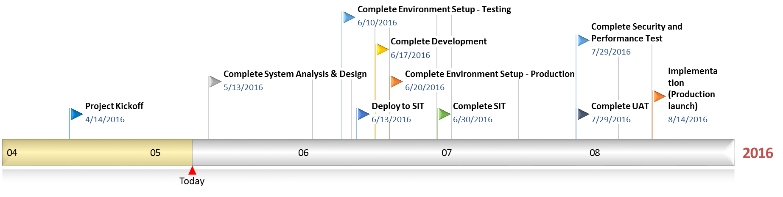
Timeline

Slide 5
Business Requirement
End to End Notifications
All the customers’ notification (SMS & Email) will be sent to agents/brokers
Touchpoint variations
Each Touchpoint is customized by Business Line, Products, Channels, Notification Content, Attributes, SMS/Email, Send-out time, etc.
Operation users approval
Operation users will be able to approve/decline notifications generated from eNotification Gateway
Customized notifications Send out time
Operation users, brokers/agents, customers will receive notifications in different time
CSO to retrieve notification history
CSO will be able to retrieve notification history for each customer form SCRUM

Slide 6

Business Requirement – End to End Notification
A centralized notification gateway, eNotification Gateway (ENG), as a common component for communication. It consists of 2 core components:
Communication Gateway (“CG”) – A light weighted engine to provide quick performance of notification distribution with future expand consideration.
It supports sending notification through email, SMS, and (next phase) other communication channel expansion capability (e.g WeChat, MyAXA)
It provides template management, querying, prioritization, preview and approval, and audit trail function
It is configurable to amend message content, send-out time, priority, and charge account
Notification History Repository (“NHR”) – It is a centralized database to store notification history from different touch points.
It would stores all the notification records including driven through communication gateway or direct triggering. Corresponding ID would be stored to facilitate enquiry purpose
Audit trail would be stored in NHR
Online enquiry and batch integration would be provided
NHR would comply to data retention policy with housekeeping in place
Quote from ARB Solution - eNotification

Slide 7


Business Requirement – End to End Notification
Core System
G/400
eNotification Gateway
RLS
1
E/B
2
4
Email / SMS
P/SEA
Staff
3
Customer policy status update by various business parties
Core system extract the notification needed for each touch point overnight and then forward to eNotification Gateway
During office hour, operation staff will review and approve/reject the notification detail
eNotification Gateway send approved notifications via different channel
Operation Staff
Quote from ARB Solution - eNotification

Slide 8
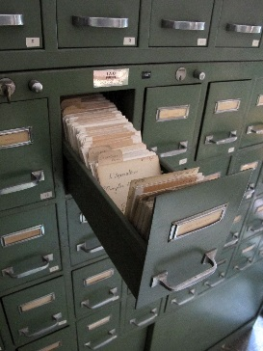



Business Requirement – End to End Notification
Notification Template Management
Notification Approval
Operation Staff / Admin
Access Management
Notification Record
Quote from ARB Solution - eNotification

Slide 9
Business Requirement – Related Users
Quote from ARB Solution - eNotification

Slide 10
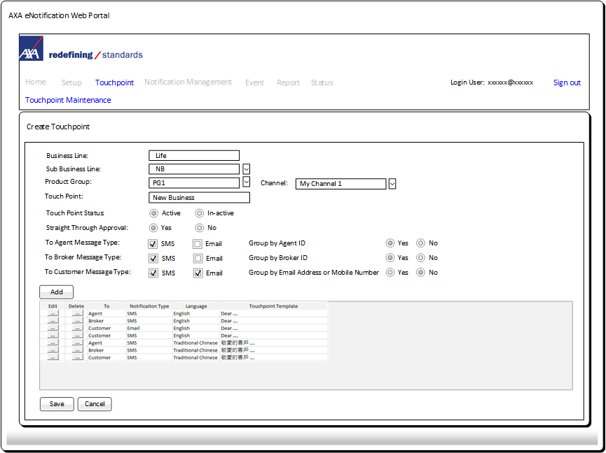
Business Requirement – Touchpoint variations
Touchpoint general information
Within a touchpoint template, define template for Agent, Broker and Customer

Slide 11
Business Requirement – Touchpoint variations
Available fields
Data Place Holder (starts with $$,ends with $$)
Available fields with Sum for grouping
Option for grouping
(Horizontal:
Rec1,Rec2…)
(Vertical:
Rec1
Rec2…)

Slide 12
Business Requirement – Operation users approval

Slide 13
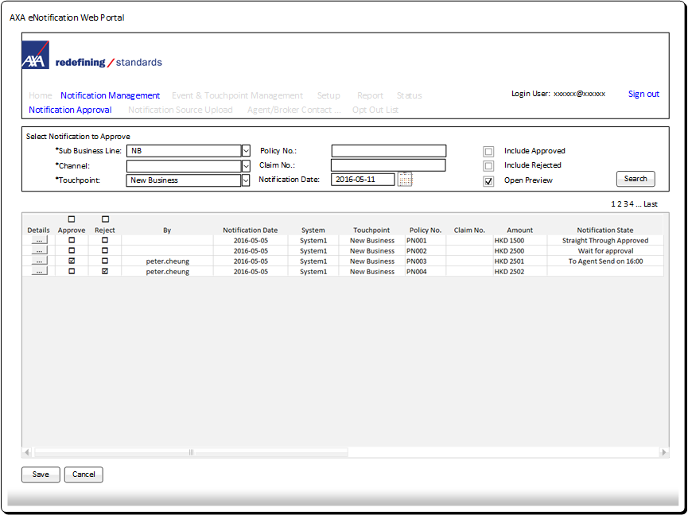
Business Requirement – Operation users approval
Search Notification for Approval
Search result displayed page by page
Select approve or reject and click Save
Approve
page by page

Slide 14
Business Requirement – Operation users approval
Notification Message
(Data)
Final form of message (Template + Data)
No template defined
Record Indicator
Approve
record by record
Approve / Reject button with navigation buttons Next, Prev provided

Slide 15
Business Requirement – Customized notifications Send out time
Specify send out time and whether message send out or not
Set Recurring option
Specify Date start and date end

Slide 16
Business Requirement – Marketing Campaign
Specify recipients email address and mobile number
Marketing message

Slide 17
Business Requirement – CSO to retrieve notification history
CSO Search by Business Line

Slide 18

Question and Answer

Slide 19
Thank You

